Slide 1

Agriculture Waste Management
18BD1A05A3
18BD1A05AA
18BD1A05AG
18PQ1A05B9

Slide 2
Outline
Abstract
Introduction
Objective
Existing System and Proposed System
Functional Requirements
Non Functional Requirements
Software Requirements
Hardware Requirements
Literature Survey
References

Slide 3
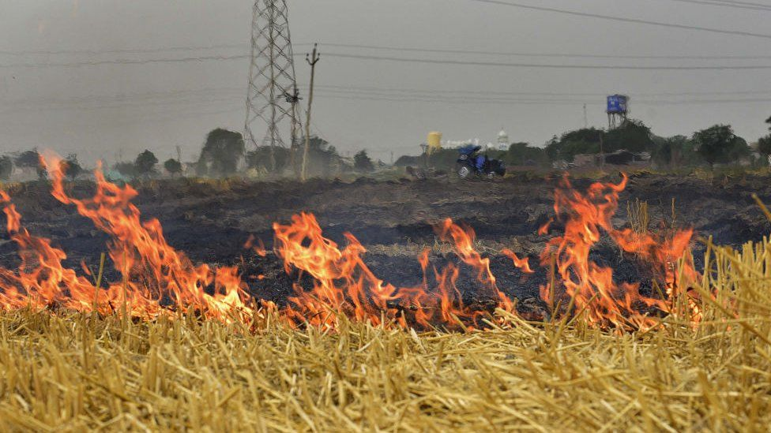
Abstract
While most of the Agritech start-ups are focused either on supply chain, focus is now expanding to farm and yield management.
The area that still remains UN-explored is the “stubble left after grain segregation”.
Stubble burning is an alarming issue today in North India.
We need to design a solution which can streamline and automate the process of stubble collection, transportation to desired location, notifications around stubble pickup and delivery, tracking of stubble disposal in a more environment friendly way.

Slide 4

Introduction
Agricultural waste is composed of organic wastes (animal excreta in the form of slurries and farmyard manures, spent mushroom compost, soiled water and silage effluent)
Waste management (or waste disposal) includes the processes and actions required to manage waste from its inception to its final disposal.
This includes the collection, transport, treatment and disposal of waste, together with monitoring and regulation of the waste management process and waste-related laws, technologies, economic mechanisms.

Slide 5
Introduction
If wastes are not properly handled they can pollute surface and groundwater and contribute to air pollution.
The proper management of waste from agricultural operations can contribute in a significant way to farm operations.
Waste management helps to maintain a healthy environment for farm animals and can reduce the need for commercial fertilizers while providing other nutrients needed for crop production.

Slide 6

Objective
The main objective of this project is to the most obvious impacts of rapidly increasing urbanization and economic development can be witnessed in the form of heaps of municipal solid waste.
Since recognizing the significance of solid-waste management, the government has been organizing multi-country workshops, seminars, and conferences to discuss related issues and problems in member countries and devise solutions.

Slide 7
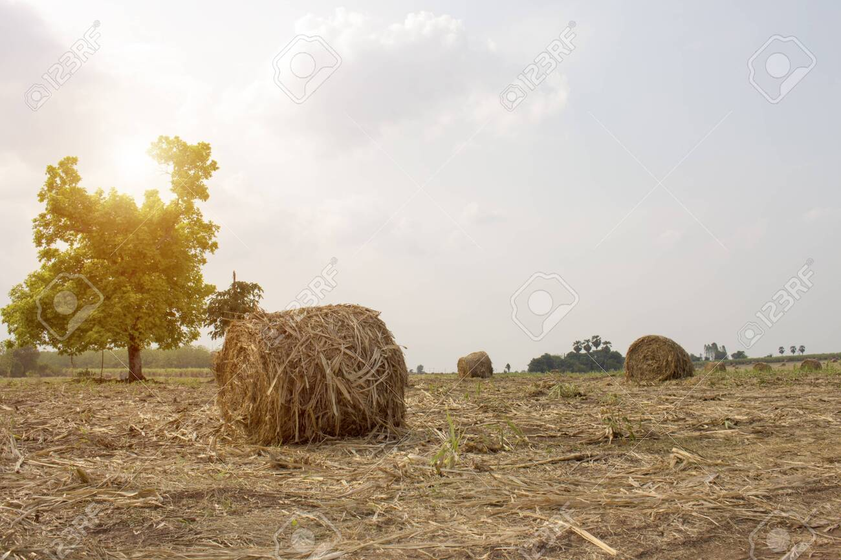
Existing System
Proposed System
Burning of farm waste causes severe pollution of land and water on local as well as regional scale. This also adversely affects the nutrient budget in the soil.
Burning of crop residue also contributes indirectly to the increased ozone pollution.
Currently there is no any technology or user friendly environment to solve this issue, the current treads of Crop residue burning is one among the many sources of air pollution.
In this project we are proposing a solution to avoiding the agricultural wastage with android application implemented in java, the proposed application is flexible to use any one.
The proposed application contain the formers, transportation, and small scale industries.
This application will make interaction between the all the type of users and it will solve the problem.

Slide 8
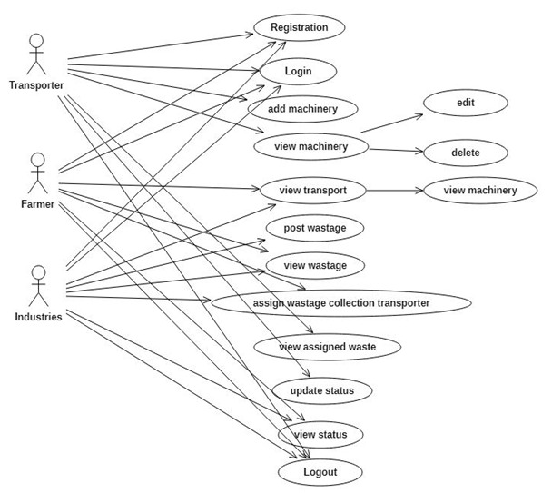
Functional Requirements

Slide 9
Non Functional Requirements
Non-Functional requirements include quantitative constraints, such as
Portability
Reliability
Usability
Time Constraints
Error messages
Performance
Security
Responsiveness
Scalability

Slide 10
Software Requirements
Database Server : Mysql
Database Client : Sql yog
Web Server : Apache Tomcat
Platform : Java
Technology : Servlets, JSP,JDBC
Client Side Technologies : Html, CSS, Java Script
IDE : Eclipse
Uml Design/E-R Modeling Tools : Rational Rose, Sql-Developer
Testing : Junit

Slide 11

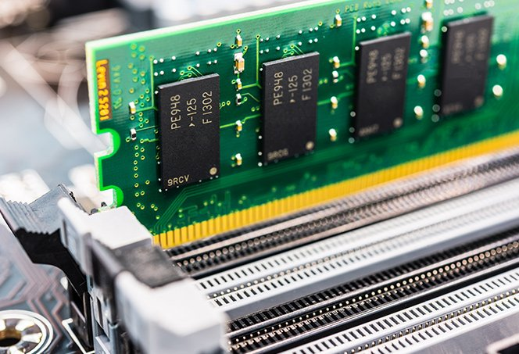
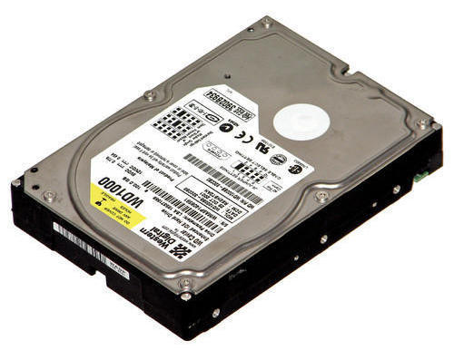
Hardware Requirements
Processor:
Ram:
Hard Disk:
I3
4GB
500 GB

Slide 12
Literature Survey
Development of A Web based GIS Waste Disposal Management System for Nigeria
Solid waste management has to do with handling of solid refuse from their sources of generation through storage, collection, transportation, recovery and treatment processes to disposal.
Solid waste also includes garbage, construction debris, commercial refuse, and sludge from water or waste treatment plants or air pollution, control facilities and other discarded materials.
This research developed a web based GIS waste disposal management system, with aim of achieving an effective waste management system and a spatial view of waste collection locations in any local.

Slide 13
Literature Survey
Management of Environmental Pollution in Ibadan, An African City:
The Challenges of Health Hazard Facing Government and The People
Ishaq Isola Omoleke
This paper examined management of environmental pollution in Ibadan, the largest City in West Africa.
Environmental pollution which includes gaseous, liquid and solid wastes have become a perennial problem facing various governments and administrations in Nigeria.
The findings of this study revealed that despite the efforts of previous and present administrations, thereby constituting health hazards such as infections, diarrhea, gastroenteritis and cholera to mention a few.

Slide 14
References
[1]Tchnobanoglous, G., Kreith, F. (2002). "Handbook of Solid Waste Management", 2nd edition, McGraw-Hill Handbooks.
Management of Environmental Pollution in Ibadan, An African City: The Challenges of Health Hazard Facing Government and The People

Slide 15

Product benefits
Cool and stylish product
Areas for community connections
Online store and market swap

Slide 16
Competitive layout
CONVENIENT
A
Contoso
EXPENSIVE
AFFORDABLE
D
C
E
B
INCONVENIENT

Slide 17
Growth strategy
How we’ll scale in the future
Feb 20XX
May 20XX
Oct 20XX
Roll out product to high profile or top-level participants to help establish the product
Release the product to the general public and monitor press release and social media accounts
Gather feedback and adjust product design as necessary

Slide 18
Traction
Forecasting for success
Key metrics
Revenue by year
 | Clients | Orders | Gross revenue | Net revenue
20XX | 10 | 1100 | $10,000 | $7,000
20XX | 20 | 200 | $20,000 | $16,000
20XX | 30 | 300 | $30,000 | $25,000
20XX | 40 | 400 | $40,000 | $30,000

Slide 19
Two-year action plan
Draft blueprints
Run focus groups
Gather feedback
20XX
JAN
FEB
MAR
APR
MAY
JUN
JUL
AUG
SEP
OCT
NOV
DEC
20XX
JAN
FEB
MAR
APR
MAY
JUN
JUL
AUG
SEP
OCT
NOV
DEC
Test design
Launch design
Deliver to client

Slide 20
Financials
 | Year 1 | Year 2 | Year 3
Income
Users | 50,000 | 400,000 | 1,600,000
Sales | 500,000 | 4,000,000 | 16,000,000
Average price per sale | 75 | 80 | 90
Revenue @ 15% | 5,625,000 | 48,000,000 | 216,000,000
Gross profit | 5,625,000 | 48,000,000 | 216,000,000
Expenses
Sales & marketing | 5,062,500 | 38,400,000 | 151,200,000 | 70%
Customer service | 1,687,500 | 9,600,000 | 21,600,000 | 10%
Product development | 562,500 | 2,400,000 | 10,800,000 | 5%
Research | 281,250 | 2,400,000 | 4,320,000 | 2%
Total expenses | 7,593,750 | 52,800,000 | 187,920,000

Slide 21




Meet the team
Takuma Hayashi
Mirjam Nilsson
Flora Berggren
Rajesh Santoshi
President
Chief Executive Officer
Chief Operations Officer
VP Marketing

Slide 22








Meet the team
Takuma Hayashi
Mirjam Nilsson
Flora Berggren
Rajesh Santoshi
President
Chief Executive Officer
Chief Operations Officer
VP Marketing
Graham Barnes
Rowan Murphy
Elizabeth Moore
Robin Kline
VP Product
SEO Strategist
Product Designer
Content Developer

Slide 23
Funding
Properties
Angel investments
Cash
Shares
$12,000
$14,000
$32,000
$82,000
Revenue obtained from property rentals
Amount obtained through other investors
Liquid cash we have on hand
Number of shares converted into USD

Slide 24
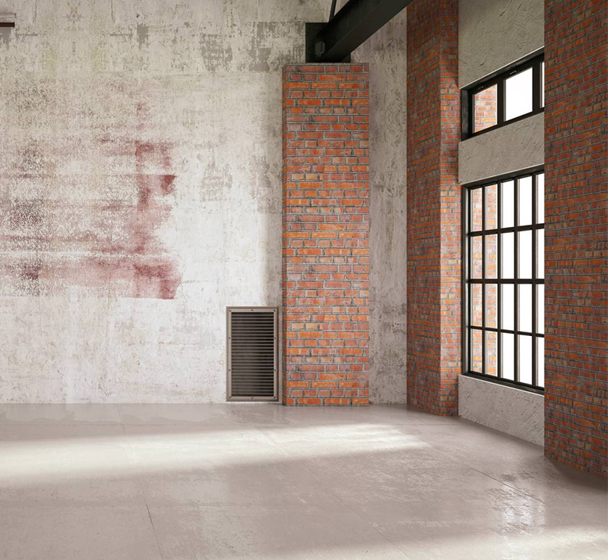
Summary
At Contoso, we believe in giving 110%. By using our next-generation data architecture, we help organizations virtually manage agile workflows. We thrive because of our market knowledge and great team behind our product. As our CEO says, "Efficiencies will come from proactively transforming how we do business."

Slide 25

Thank you

